Slide 1

Rural vs. Urban
Brent Bogan
Where’s the better education?

Slide 2
Research Question
What is the more advantageous environment for a child to better achieve a basic education in?

Slide 3


Interested Parties
Parents
Researchers
Governments

Slide 4
Data
Education Statistics
The World Bank
Includes:
Countries (45)
Year: 2018
Series: Proportion of students at the end of lower secondary education
achieving at least a minimum proficiency level

Slide 5
Hypotheses
H1:
H2:
There is no significant difference in the minimum proficiency level achieved for mathematics between rural and urban environments.
There is a significant difference in the minimum proficiency level achieved for reading between rural and urban environments.

Slide 6

Mathematics
REJECT THE NULL
With a p-value of .0005, there is a statistically significant difference of the minimum proficiency level achieved for mathematics between rural and urban environments.

Slide 7
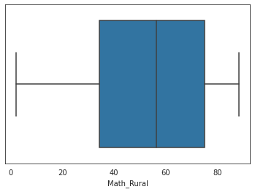
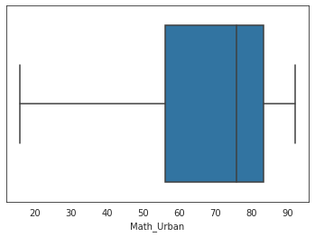
Math Charts

Slide 8

Reading
REJECT THE NULL
With a p-value far less than .05, there is a statistically significant difference of the minimum proficiency level achieved for reading between rural and urban environments.

Slide 9
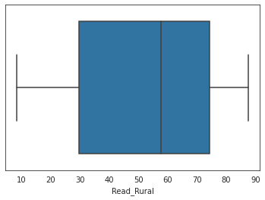
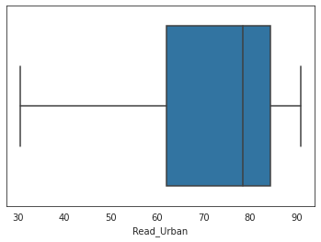
Reading Charts

Slide 10

Recommendations
Families should move to an urban environment
Researchers should include environment as a significant factor in education quality
Governments should focus educational funding on rural environments to help increase level of education

Slide 11

Thank You!

